Slide 1
Chapter 3
Networks and Telecommunications

Slide 2
Outline
What is the value of a single computer?
Why are computer networks so important in today’s businesses?
What components do you need to install to create a network?
How can multiple users share a single network?
How is it possible that you can connect your computer to a network at the office, at home, or while on the road, even overseas?
What is the Internet, how is it controlled, and how does it work?
Are personal computers necessary anymore?
What problems are you likely to encounter if you need to connect to a supplier in a different country?

Slide 3


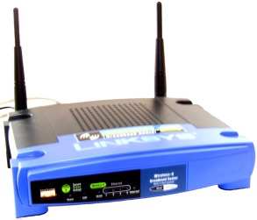



Networks
Internet
Services
Applications
Research
Hosting
External
Internal
Suppliers
Customers
Banks
Teamwork
Communication
Scheduling
Sharing

Slide 4


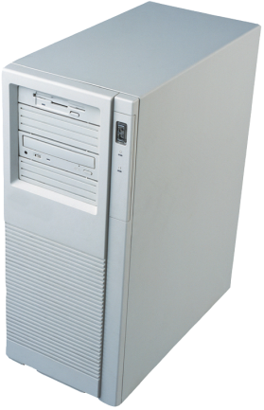
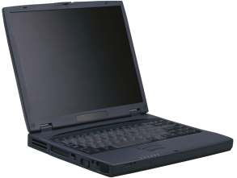
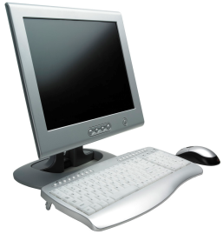

Sharing Data: Transactions
Internet
Database Management
System and Web Server
Or Point-of-Sale system

Slide 5
Sharing Data: Decisions & Collaboration
Decisions & collaboration
Teamwork & joint authorship
File Server and Database
Team Document
Report and
Comments

Slide 6




Sharing Data: E-mail
Internet
2. Message transferred to account on server.
3. Transferred via the Internet to the destination account.
4. Message received when user checks e-mail.
1. User creates e-mail message.

Slide 7
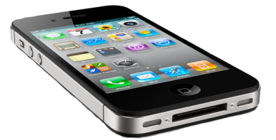
Sharing Data: Calendars
8:00 Mgt meeting
8:30 (open)
9:00 Staff meeting
9:30 Staff meeting
10:00 new meeting

Slide 8
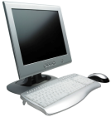
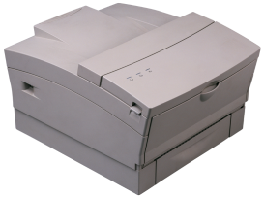
Hardware Sharing
Printers
Storage
Processors
Corporate or
external computer
access
tape drive
(backup)
Workstations
Shared Printer
Server
Files are transferred from workstations to the server.
Software automatically copies files to tapes.
LAN administrator can restore files if needed.

Slide 9
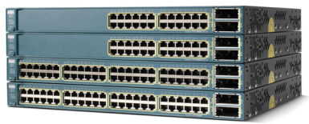
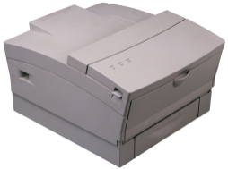
Network Components
Computers
Servers
Work stations
Media
Cables
Fiber optic
Radio
Infrared
Connection devices
Personal Computer
LAN card
Personal Computer
LAN card
Internet
Router
LAN card
LAN card
Switch
Shared Printer
Firewall
Server

Slide 10
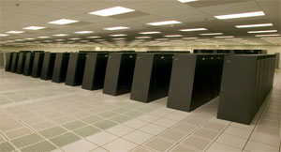
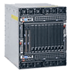
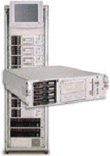
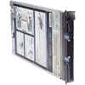
Server Scalability
Server farms distribute the workload. Add more computers for more power.
https://asc.llnl.gov
IBM Blue Gene/L
Increasing performance within a product family.
IBM PS702 Express
(multiple blades)
Rack mount server farm.
HP
IBM PS700 Express

Slide 11
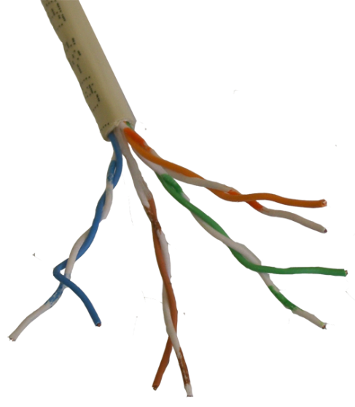
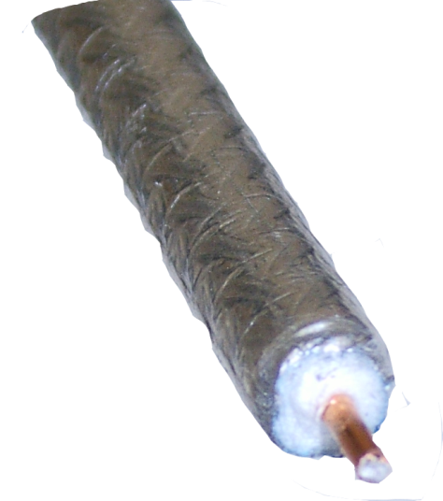
Network Transmission Media
Fiber Optic Cable
Example:
Long distance phone lines
reflective cladding
Twisted Pair
Example:
Local phone lines
glass or plastic
Radio or Micro Waves
Example:
Cellular phones
antenna
Coaxial
Example:
Cable TV

Slide 12

Fiber Optics
Faster
More data
Less magnetic interference
Long stretches without repeaters
900 copper wires can be replaced by one fiber optic line (for telephone connections).

Slide 13
Frequency Spectrum
AM: 550K - 1650 KHz
TV: 54M - 216 MHz
TV: 220M - 500 MHz
Navy/submarines
FM: 88M - 108 MHz
ELF
VLF
LF
MF
HF
VHF
UHF
Microwave
Optical
100
1K
100K
1M
10M
100M
1G
10G
Hertz
All waves have similar elements
Sound
Radio
Micro
Light
Frequency differences
Amount of data
Distance
Interference / Noise
Public Safety: 150M - 160 MHz
Public Safety: 460M - 500 MHz
Cordless phones (some): 900 MHz
Cellular phones: 800 MHz
PCS ET: 2 GHz
Pers. Com. Sys (PCS): 1.85 G - 2.2 GHz
http://www.ntia.doc.gov/osmhome/allochrt.pdf

Slide 14


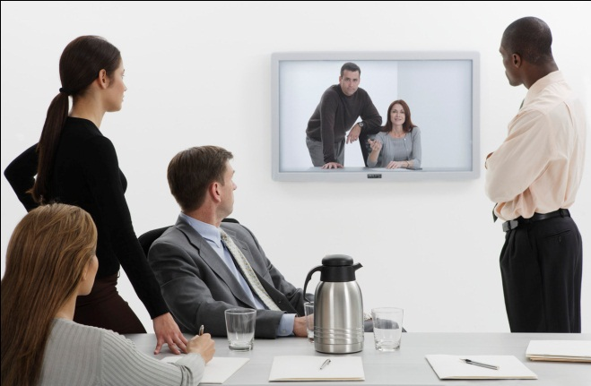
Wireless Technologies
Cellphone or WiMax
2-10 miles, 128 kbps - 10 mbps (4G)
Bluetooth
10-30 feet
2.1 mbps
3.0: 24 mbps
Ultra-wideband
10-30 feet
1 gbps
Wi-Fi
50-200 feet
11 mbps - 250 mbps

Slide 15
Transmission Capacity
Local Area Networks
Name | Format | Speed (mbps)
10Base-T | Twisted pair | 10
100Base-T | Twisted pair | 100
Gigabit Ethernet | Twisted pair | 1000
Wireless LAN 11b,a,g | Wireless | 11-54
Wireless LAN 11n | Wireless | 150-200
LAN/fiber FDDI | Fiber optic | 100
LAN/fiber ATM | Fiber optic | 155
LAN/fiber high-end | Fiber optic | 100,000,000 (100 terabits)
Internet Connections
Name | Format | Speed (mbps) | Estimated Cost
Dial-up | Twisted pair | 0.05 | $20/month
DSL | Twisted pair | 3+ down/0.5+ up | $50/month
Cable modem | Coaxial | 6+ down/1+ up | $50/month
Satellite | Microwave | 1.5 down/0.25 up | $50/month
Wireless/Wi-Max | Microwave | 1.5-6 down/0.25+ up | $40/month
T1-lease | Twisted pair | 1.544 | $400-$700/month
T3-lease | Fiber optic | 45 | $2,500-$10,000/month
ATM | Fiber optic | 155 | $15,000-30,000/month
OC-3 | Fiber optic | 155 | $16,000-$20,000/month
OC-12 | Fiber optic | 622 | $20,000- $70,000/month
OC-48 | Fiber optic | 2,488 | $50,000 - ?/month
OC-192 | Fiber optic | 9,953
OC-768/future | Fiber optic | 39,813

Slide 16
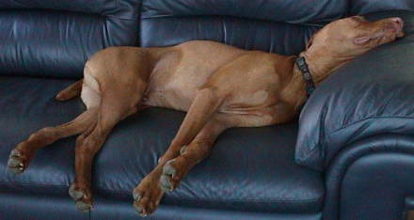
The Importance of Bandwidth
For interesting Internet connections at specific buildings:
http://www.cogentco.com/us/pns_dedicated.php

Slide 17
Connecting Networks
The need for standards
A changing environment
Internet
Backbone fiber optic
Routers or Switches
Switch
Hub
Hub
Radio-based network

Slide 18
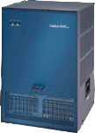
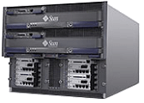

Enterprise Network
Building 1
Building 2
Fiber optic
Switch
Servers
Firewall
Workstations/PCs
Internet – ISP
Subsidiary

Slide 19
Packet-Switched Networks
All data is converted to packets.
Packet has data, destination, and source address.
Switched services.
Packets routed as needed.
Reassembled at destination.
Voice
Sent as packets: 1 2 3 4 5
B
Chicago
2
New York
C
4
A
E
1
Atlanta
Dallas
D
3
5
Computer
Sent as packets: A B C D E

Slide 20
Shared Connections
With shared connections, machines have to take turns, and congestion can slow down all connections.
With switched connections, each computer has the full bandwidth of the connection at all times. Performance depends on how fast the switch can handle connections.

Slide 21
Switched Network
Switch
Servers
Workstations/PCs

Slide 22
Shared-Media Network
Tap
Shared Media

Slide 23
Time Division
A
B
A
C
A
C
A
time
C
D
Computers A and B split their messages into packets and share
the transmission medium by taking turns sending the data.

Slide 24
Frequency Division
A
B
frequency
A
3500 Hz
C
C
D
Computers A and B split the frequency: A uses a higher spectrum.
By listening only to the assigned frequency, multiple transmissions
can occur at the same time.

Slide 25
Spread Spectrum
frequency
A
B
C
D
time
Sharing a medium by both frequency and time is one method
of spread spectrum transmission. It is efficient for many computers
because the full bandwidth can be utilized over time and frequency.

Slide 26

Wireless Communication
Microwave transmissions are used to provide communications for cellular phones and laptop computers. As prices of phones, portable computers, and communication costs decrease, increasing numbers of workers are choosing wireless technologies.

Slide 27

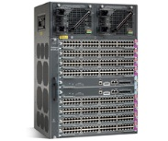
Managing Shared Networks
1. Each person views simple data/Web pages.
Capacity is not pressed. Usage is even.
Shared: 1.5 mbps
Phone or Cable
Company/ISP
2. One person views 1mbps streaming video.
Capacity is pressed. All traffic slows down.
Is this person a “bandwidth hog?”

Slide 28
Options for Managing Traffic
Prioritizing Traffic
Slow down some users—perceived hogs.
Slow down based on type of traffic.
Packeteer—open packets to identify.
Connection port (rare, not very useful).
Sell quality of service (rare yet).
Pricing mechanisms with data caps
Overage fees
Differential pricing
Time-of-day pricing (rare yet).
Potential problem as speeds increase (4G cell).

Slide 29
Government Interference or Necessity?
“Network Neutrality” Proposal
Potential problem: A commercial network might intentionally slow down traffic from a rival. For instance, Comcast (network) owns NBC (content) (January 2011). What if it slows down traffic for competitor content?
But does “neutrality” mean that networks cannot manage their usage?
Are network and cell phone ads misleading?
Watch movies on your cell phone.
Do it on 4G and see how quickly you exceed the data cap.
What are actual network speeds?
FCC says perhaps half in 2010. (PDF)

Slide 30
Data Caps
Cap: 5 GB
Transfer rate: 5 mbps
8 bits
Byte
5,000,000,000 Bytes
1
5,000,000 bits/sec
40,000,000,000 bits
1
60 sec/minute
8,000 seconds
133.33 minutes

Slide 31
TCP/IP Reference Model
4. Application
3. Transport (TCP)
2. Internet (IP)
1. Physical
Message
Header 3
Message
Trailer 3
Header 2
Header 3
Header 3
Message
Message
Trailer 3
Trailer 3
Trailer 2
Header 1
Header 2
Header 3
Header 3
Message
Message
Trailer 3
Trailer 3
Trailer 2
Trailer 1

Slide 32
TCP/IP Reference
Application
Mail, Web, FTP
Authentication, compression, user services
Transport
Packetize data and handle lost packets
Establish connections through numbered ports
Internet Protocol (IP)
Route packets to destination
Requires unique host addresses: IPv4=32-bit; IPv6=128-bit
Requires standards and cooperation
Subnet
Physical connections
Transfers bits with some form of error correction

Slide 33
ISO-OSI Reference Model
Layer 7
Application
Original Data
Application
Layer 6
Presentation
Translate
Presentation
Layer 5
Session
Sign on and resources
Session
Layer 4
Transport
Transport
Data Packet
Layer 3
Network
R
Add routing data
Network
Layer 2
Data Link
Addresses &
Error Check
Data Link
A
R
C
Layer 1
Physical
A
R
C
A
R
C
Physical
Physical Media

Slide 34
Introduction to the Internet
No control
Services
E-Mail
Telnet
FTP
WWW
WEB searching
Google
Yahoo
Bing/Microsoft
The Internet

Slide 35
How the Internet Works
Network
service
provider (NSP)
OC3: 155.52 Mbps
OC12: 622 Mbps
T1: 1.544 Mbps
T3: 44.736 Mbps
Backbone
network
Internet
service
provider (ISP)
Phone
company
Cable
company
Phone
company
Dial-up: 33.3 - 56 Kbps
ISDN: 128 Kbps
DSL: 256 Kbps - 6 Mbps
Cable: 1.5 Mbps
Company
Web site
Individual

Slide 36
Internet Connections
Some backbone providers
AT&T
Level 3
Verizon (UUNet)
Sprint
Qwest
PSINet/Cogent
Global Crossing
Cable & Wireless
http://navigators.com/isp.html
http://www.nthelp.com/maps.htm
http://advice.cio.com/themes/CIO.com/cache/Internet_map_labels_0.pdf
Phone companies
Regional Bell operating companies (RBOCs) (3)
Competitive local exchange carriers (CLECs) (new)
Cable companies
Cablevision
Comcast
Regional
Cell phones/Mobile
Satellite
Direct Satellite
Wild Blue/Starband/Hughes

Slide 37
Colocation and Hosting Companies
General Data Centers Multiple high-speed Internet connections, power with UPS, air conditioning, and security | Equinix Cybercon Savis Telecity (Europe)
Specialty Hosting Companies Individual contracts to perform specific tasks including hosting. | IBM AT&T EDS Thousands of small, regional providers

Slide 38

Distributed Content through Akamai
Akamai Servers
Company Server
Internet
Content Video
By distributing your content to servers at the “edge” of the Internet, customers retrieve data from multiple points, reducing the load on your server and Internet connection.
http://www.akamai.com

Slide 39


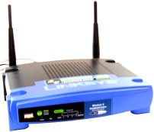
Voice Over IP (VoIP)
VoIP Provider
Telephone Co.
Internet
Cable modem
Skype
Vopium (Dutch)
Vonage
Voice to IP

Slide 40
Network Address Translation (NAT)
Web Server
Translate:
10.1.30.15=138.9.1.15
10.1.30.15
Disallow incoming
peer-to-peer

Slide 41

Domain Name System Registration
Internic.org
DNS
Registration
Internet World
ISP
207.46.250.222
www.microsoft.com
Microsoft Corporation
One Microsoft Way
Redmond, WA 98052
US
Arin.net
Net Range
207.46.0.0 – 207.46.255.255
Microsoft-Global-Net
Real World
Internet entities are anchored to the real world through the DNS registration and through their ISP.
If they tell the truth!

Slide 42
Domain Names
Right-to-left
Original TLDs
Set by ICANN
com
org
net
edu
gov
mil
Many more today +
Country Codes
Server.Department.Company.TLD
Optional
Required
accounts.citibank.com.xqioajfm.aka82.com
This address is NOT owned by Citicorp.
When you see it in an e-mail message, you know it is a fake.

Slide 43
Internet2
High speed (1 gbps or better)
Quality of Service (QoS)
Primarily educational and research
Requires fiber connection
Basic costs
Connection (1gbps) $250,000 per year
Membership about $60,000 per year
It is not designed for commercial Web sites

Slide 44
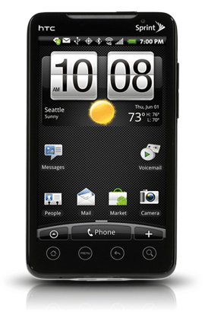
M-Commerce
Internet access everywhere
Cell phones
Tablets
Laptops
Great potential
Limited usability
Better than voice?

Slide 45

Cell Phones and Wireless Communication
Wireless cells work by handing off the wireless connection to the next tower as the caller moves.
Connections to multiple towers at one time enables the system to triangulate to get a fairly precise location of the cellular device--even when it is not in a call.
Location knowledge will make it possible (although perhaps not desirable) to offer new business opportunities as people move into range.

Slide 46

Cloud Computing
Server and data
Display
browser
application

Slide 47
Cloud Computing: Lease v. Buy
Hardware
Software
Support personnel
Fixed v. Monthly costs
Security
Similar concepts to “outsourcing” covered in Chapter 13

Slide 48
Global Telecommunications
Technical problems
Multiple standards
Language
Developing nations
Time zones
Limits to space & waves
Political complications
Transborder data flows
Taxes
Privacy
Accessibility
Cultural issues
What is an object?
Management & control

Slide 49
Technology Toolbox: Creating Web Pages
<HTML>
<HEAD><TITLE>Sample HTML Page</TITLE>
<BODY>
<H1>Section One</H1>
<P>This is a sample paragraph on a sample page.</P>
</BODY>
</HTML>
HTML
Tables for Layout
Page Editors
Images are bitmaps: GIF, JPEG, PNG
Adobe PDF

Slide 50
Technology Toolbox: Transferring Files
Connection | Strengths | Weaknesses
FTP | Inexpensive and easy to use. | Need to find secure version.
WebDAV | Internet standard and can be secure. | Web server security is weaker by allowing directory browsing.
VPN | Secure if encrypted all the way to the Web server. | Difficult to configure the server side and the client needs to connect separately to the VPN.
Web upload | Easy to use. HTML 5 might make it easier. | Need server code to handle the file transfers and updates. Still need a secure Web site for login.

Slide 51
Cases: Wholesale Suppliers

